Slide 1
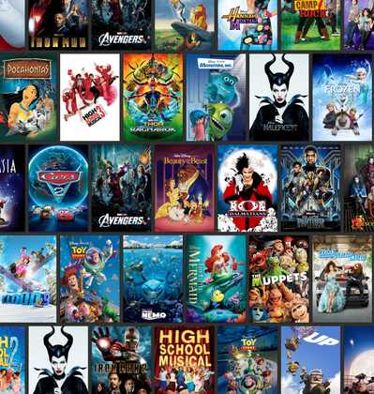
STAR MOVIES APP
Team Members:
Abhishek
Ishita
Rashmi
Vandana
Yash GUPTA
Ayushee
Sohit
Anubhav Gupta

Slide 2
Problem Statement
Goal
Build a complete personalized movie store for customers for streaming the movies online .
Requirements
Static view
Search Button
Movie Card
Dashboard – Trending Movies, Forthcoming Movies, Recommendations

Slide 3



Outline
Problem Statement
Background
Solution Architecture
Implementation
Proposed Future Enhancements

Slide 4
Solution Architecture
Key components:
Client Application
Node JS server
TMDB API
Client Server
Node JS Server
TMDB API

Slide 5


Working Solution
Platforms
Servers hosted on AWS
T2.micro and M3.xlarge EC2 instances
Linux 2.0 LTS
MySQL
Languages
Java Script

Slide 6
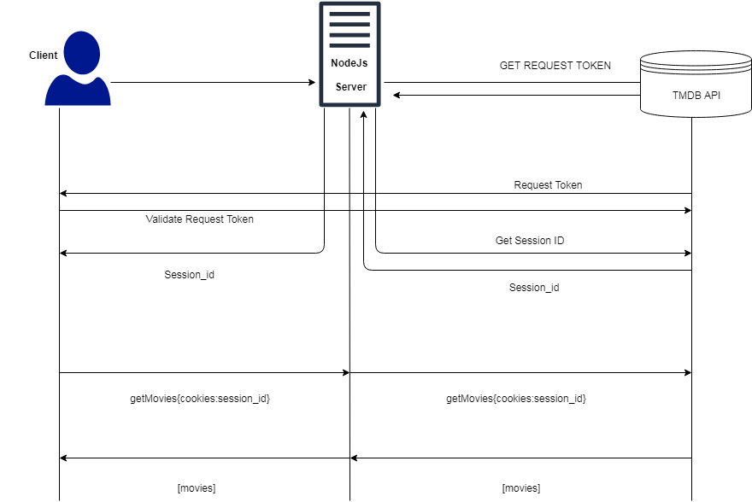
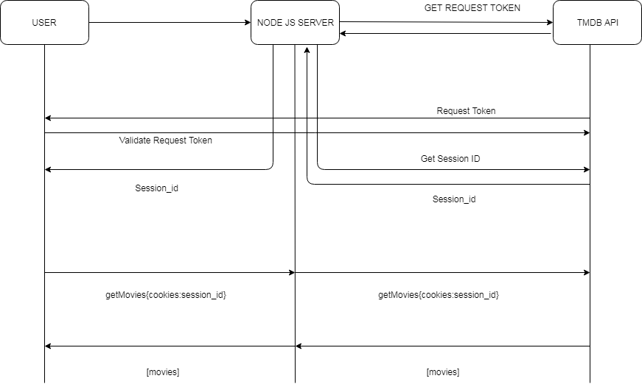

Slide 7
Link to the Working Code
https://github.com/rayshu/Hackathon-Team-3

Slide 8
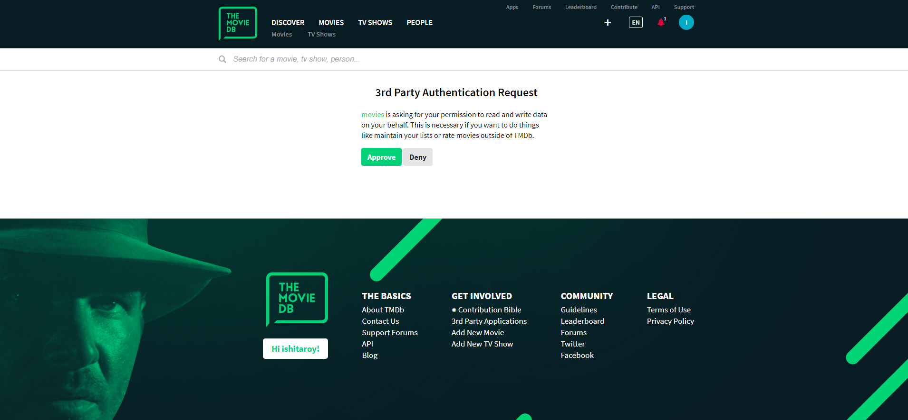

Slide 9
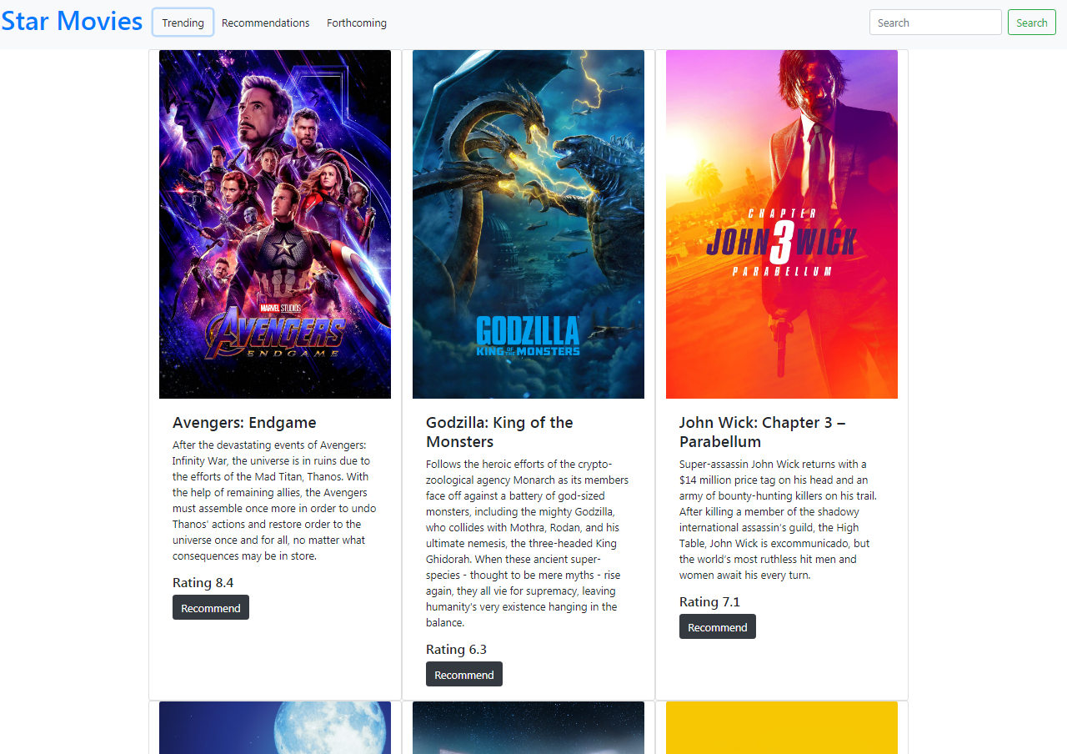

Slide 10
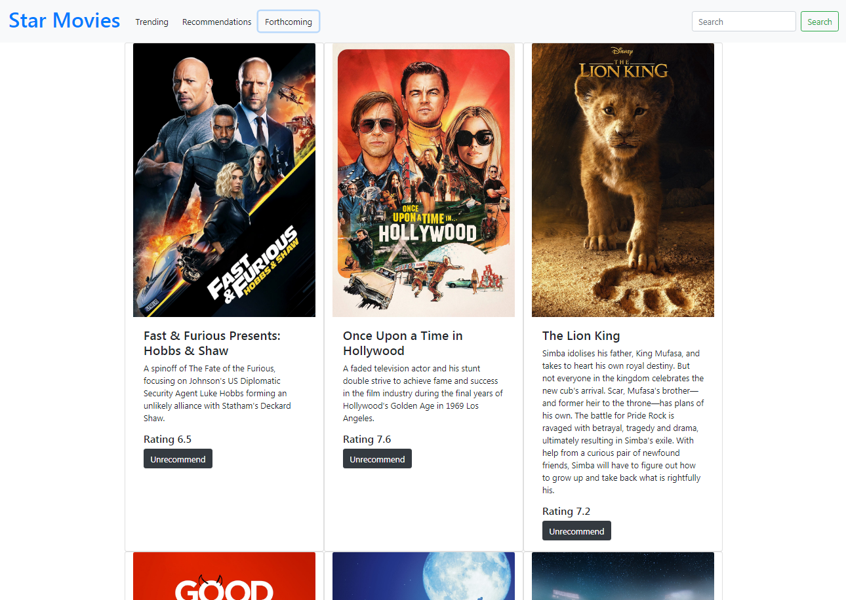

Slide 11
Proposed Future Enhancements
To make the frontend more interactive.
To improve the performance as per the increased client requests.
To improve the criteria to rate movies.
To enhance the security

Slide 12
Thank You

